Slide 1
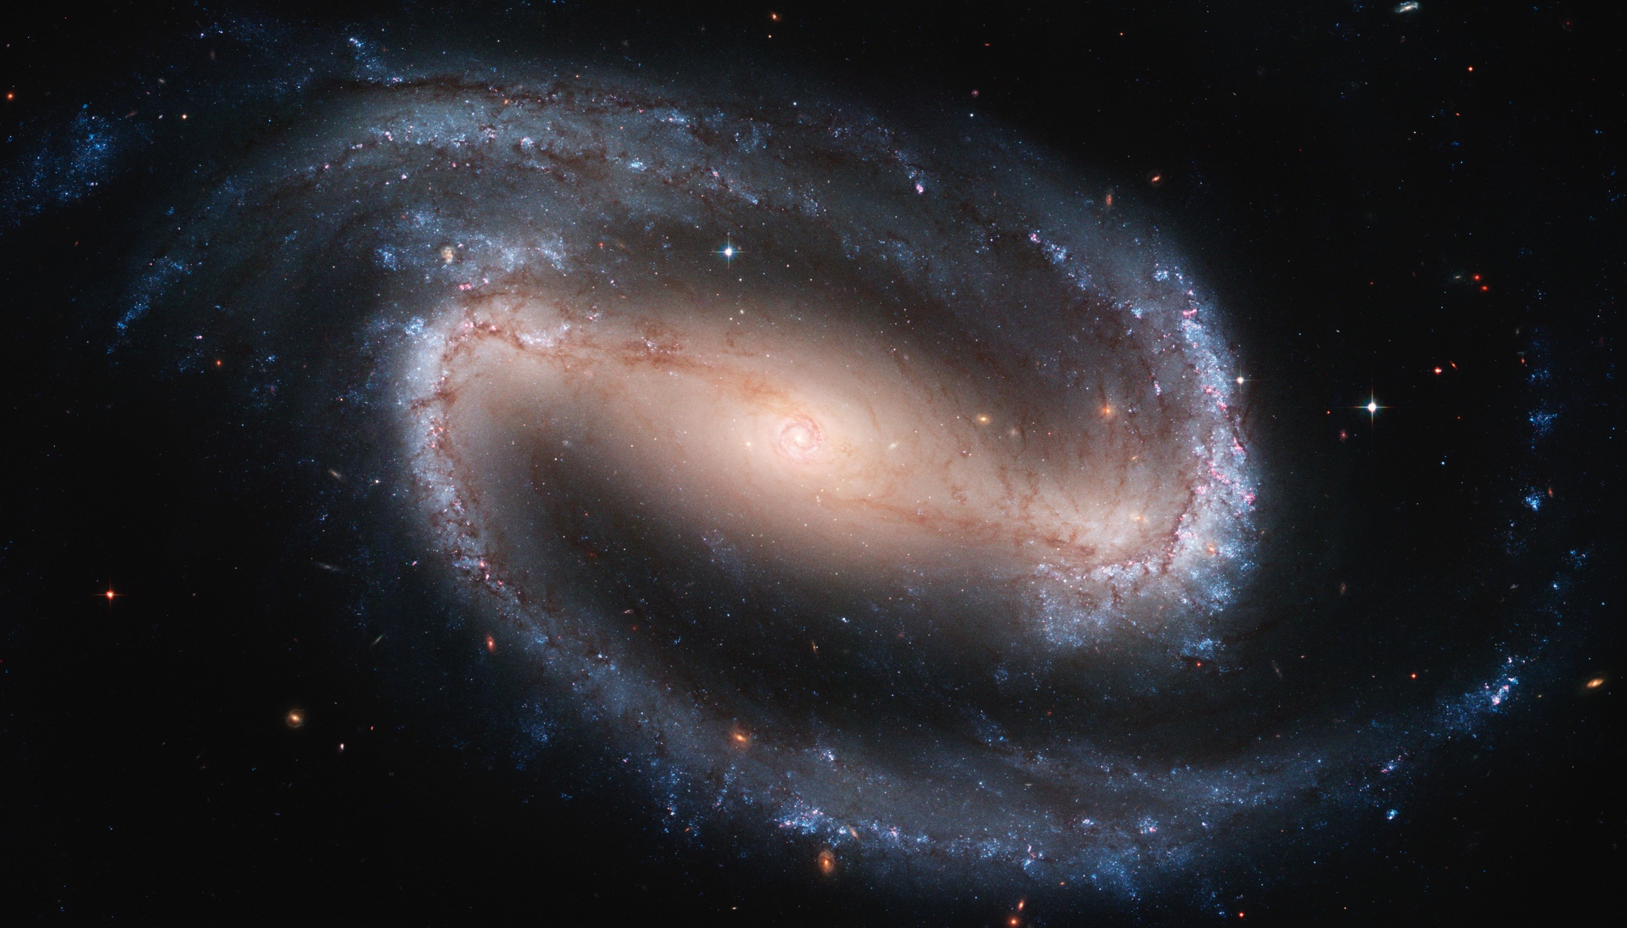
NServiceBus introduction
Boris Tveritnev
27/08/2015
http://apod.nasa.gov/apod/image/1203/ngc1300_hst_6637.jpg

Slide 2





Particular software
NServiceBus
Messaging and Workflow
ServicePulse
Production Monitoring
ServiceMatrix
Modelling & Design
ServiceInsight
Advanced Debugging

Slide 3
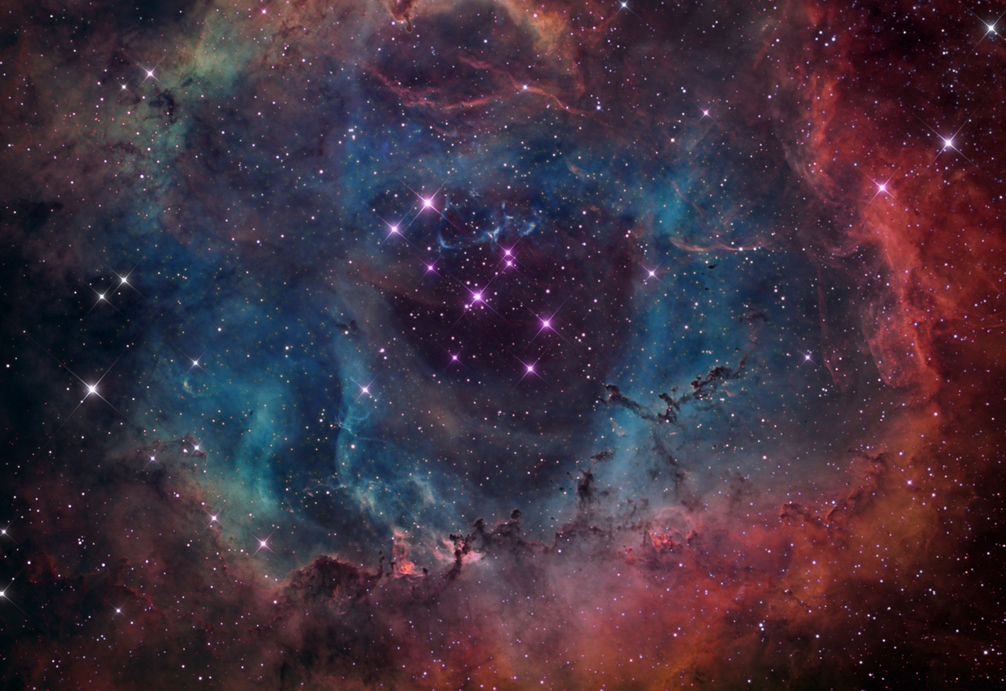
What service bus is?
Think of your system as passing messages between components
Dynamic routing
No bindings to physical location
Messages addressed to logical locations
Infrastructure makes sure messages get to the recipient, even if they change physical locations
http://www.heavensgloryobservatory.com/Color_Jpegs/ngc2244NB03.jpg

Slide 4
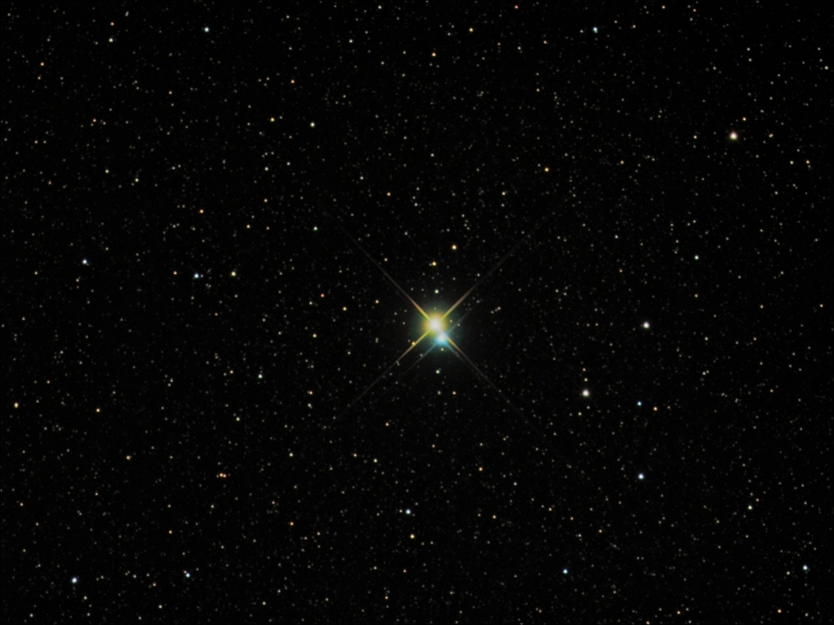
NServiceBus features
Publish / Subscribe
Long-running stateful processes
Client can send messages if server is offline
Poison message detection and dispatching
Poison messages re-processing
Subscriptions persist after restart
Polymorphic message dispatch
Message-driven unit testing

Slide 5
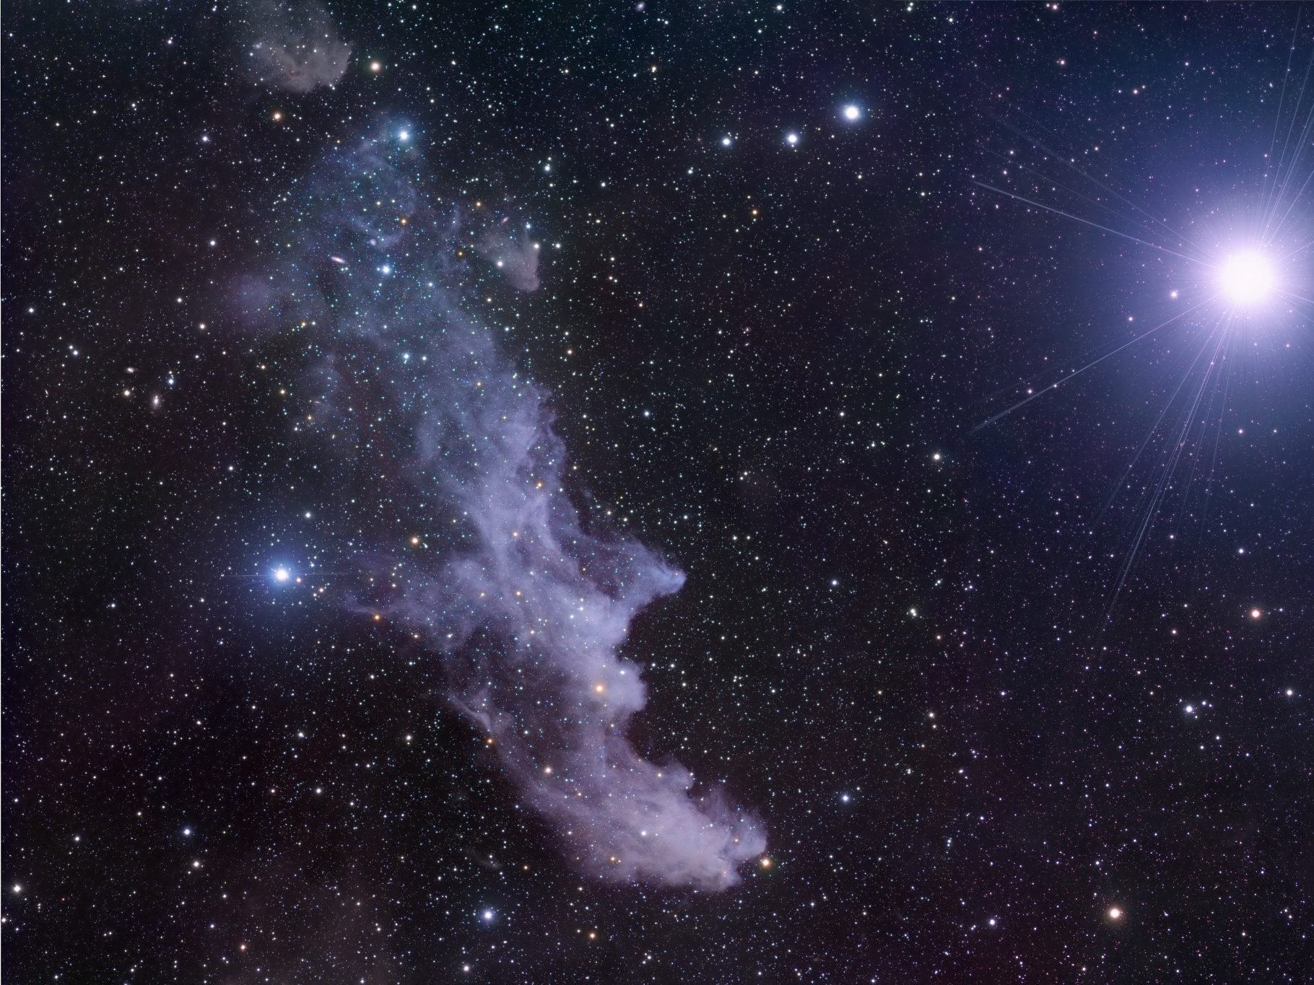
Messaging transports
MSMQ
SQL Server Service Broker
AMQP brokers (ActiveMQ, RabbitMQ)
Cloud queues (Azure Queue, Amazon SQS)
Many more
http://apod.nasa.gov/apod/image/0810/ic2118_ssro.jpg

Slide 6
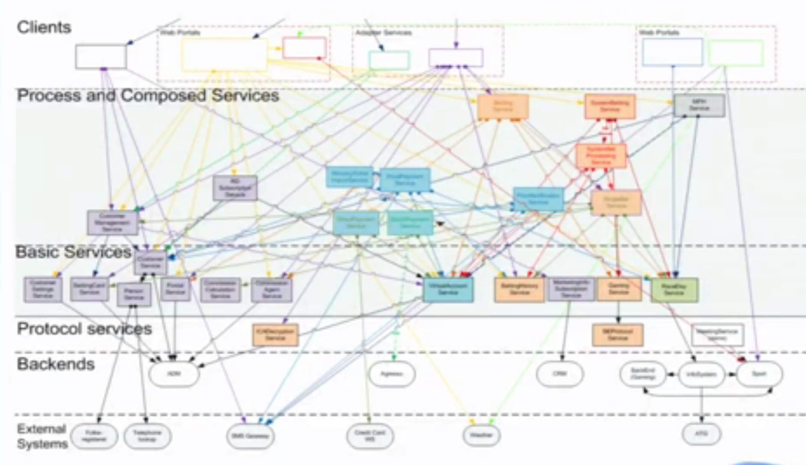
Ugly slide

Slide 7
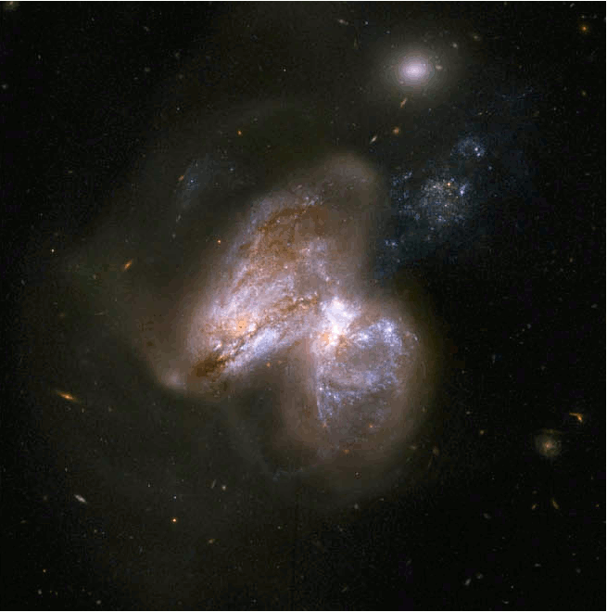
Challenges with RPC
Deadlocks under load
Order processing failures - we lose money
Put yours
http://www.space.com/28254-monster-black-hole-nasa-nustar-image.html

Slide 8
What service bus is?
Think of your system as passing messages between components
Dynamic routing
http://www.heavensgloryobservatory.com/Color_Jpegs/ngc2244NB03.jpg

Slide 9
Asynchronous messaging
Command messages (Request-Response)
Event messages (Publish-Subscribe)
http://apod.nasa.gov/apod/image/0508/albireo_yandrik_big.jpg

Slide 10
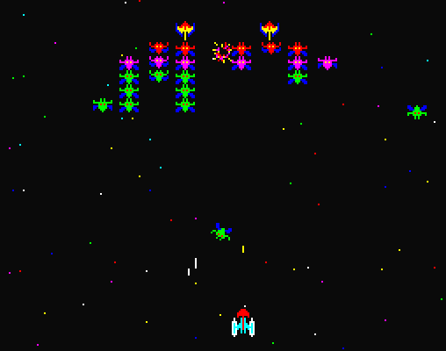
Request-Response, sort of
Many clients, one server
Server’s capabilities are known
Server’s location is known
Strong coupling
http://old-computers.com/MUSEUM/software/Sharp_X1_Galaxian_S.PNG

Slide 11
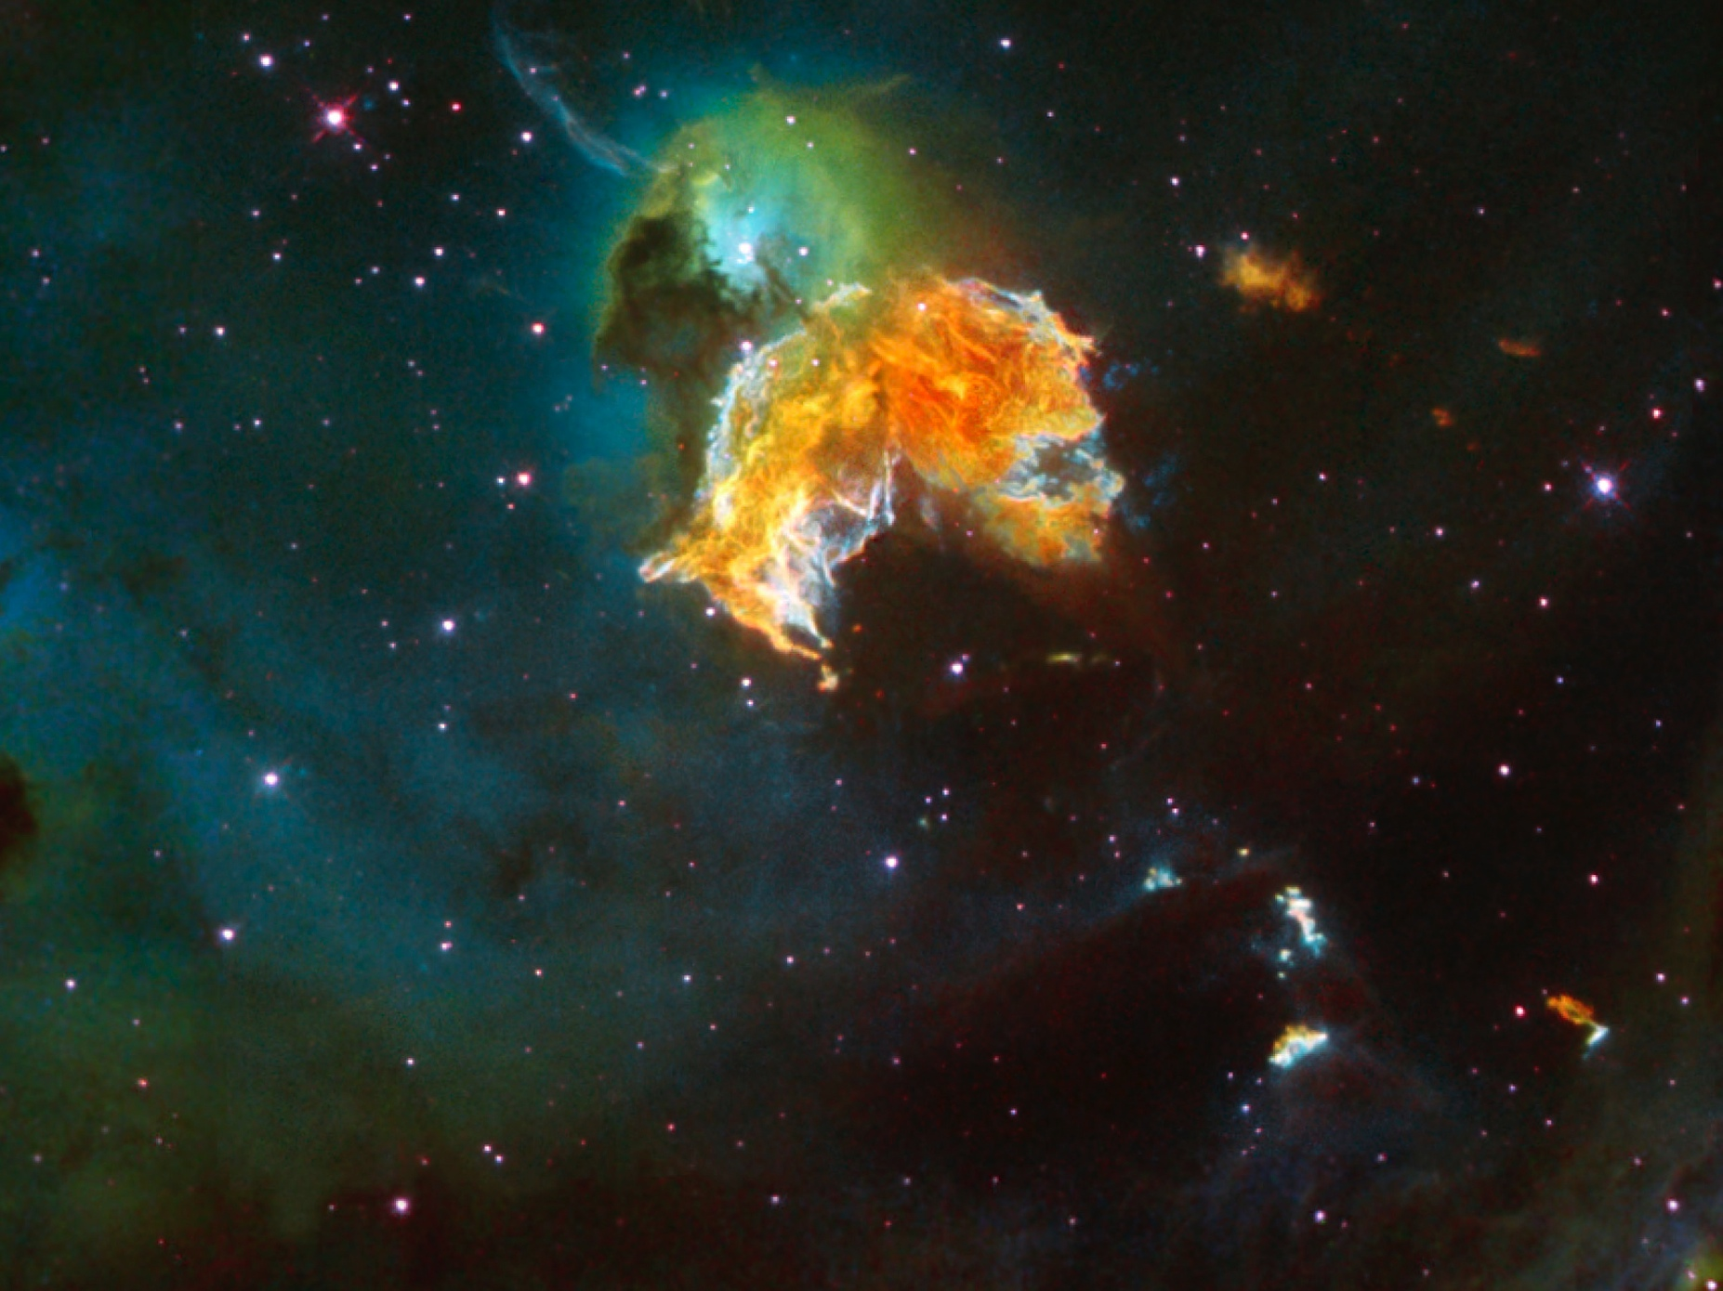
Eventual consistency
Consistency (for a short period)
Availability
Partition tolerance
http://www.nasa.gov/sites/default/files/images/117227main_image_feature_342_ys_full.jpg

Slide 12
Example 1
Reliable requests processing

Slide 13
What service bus is?
No bindings to specific location
Messages addressed to logical locations
Infrastructure makes sure messages get to the recipient, even if they change physical locations
http://www.heavensgloryobservatory.com/Color_Jpegs/ngc2244NB03.jpg

Slide 14
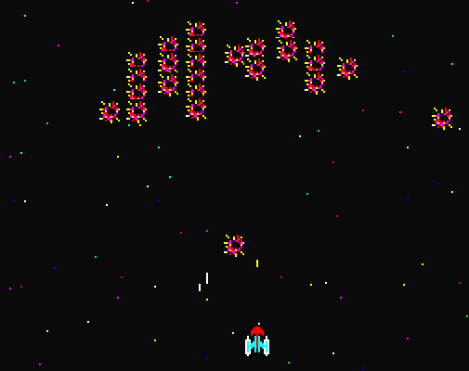
Publish-subscribe
One (logical) publishing authority, many subscribers
Publisher doesn’t care about subscribers
Loose coupling
http://www.mdscc.nasa.gov/upload/201301/andromeda.jpg

Slide 15
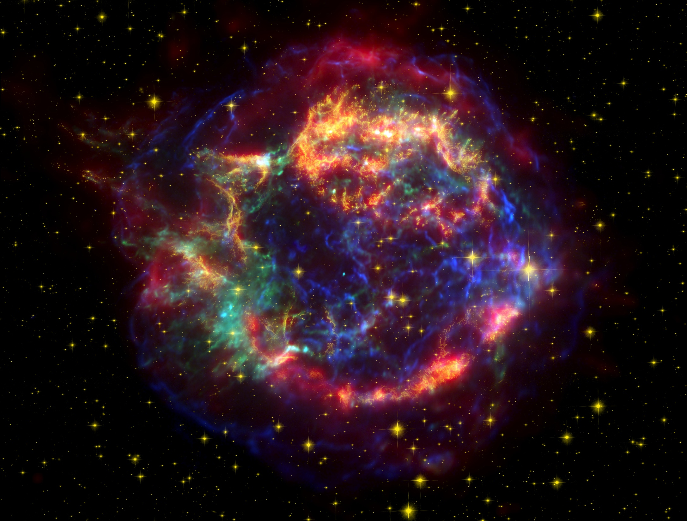
Polymorphic dispatch/routing
Version API through multiple inheritance
Introduce new handlers/subscribers without touching any of the other subscribers
Upgrade existing components step by step without taking the whole system down
http://www.nasa.gov/centers/goddard/images/content/280046main_CassAcomposite_HI.jpg

Slide 16
Long-running processes
A retailer can't ship a product until the CC has been charged
A customer can attain a preferred status only after spending a certain amount of money
Premium membership is in effect as long as all invoices were paid in time
http://www.nasa.gov/sites/default/files/images/117227main_image_feature_342_ys_full.jpg

Slide 17

Saga patterns
Controller that actively manages business process activities
Observer, passively listening to external events, coordinating some activity
Mixed
http://i.stack.imgur.com/lFnDf.jpg

Slide 18
Example 2
Loosely coupled services with Pub-Sub
Long running process

Slide 19
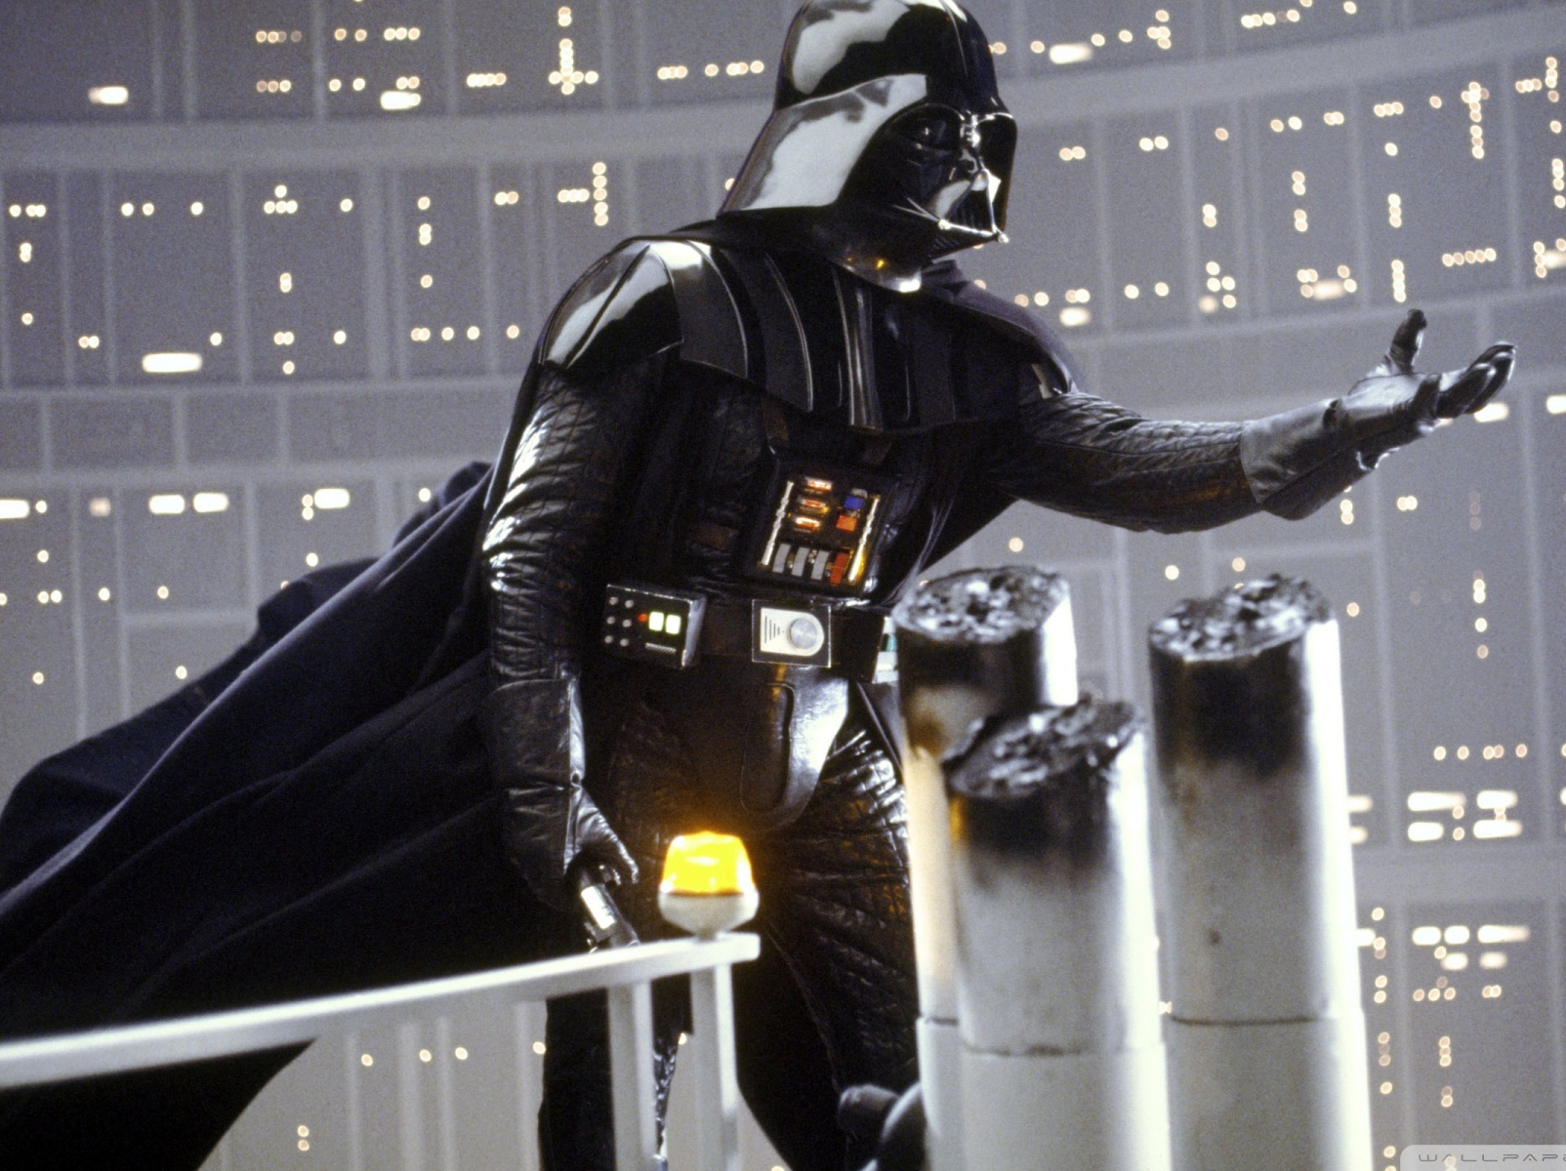
The takeaway
Designed around distributed systems fallacies
Simplifies the development of scalable distributed systems
Reduces cost of development and maintenance
Cookies

Slide 20
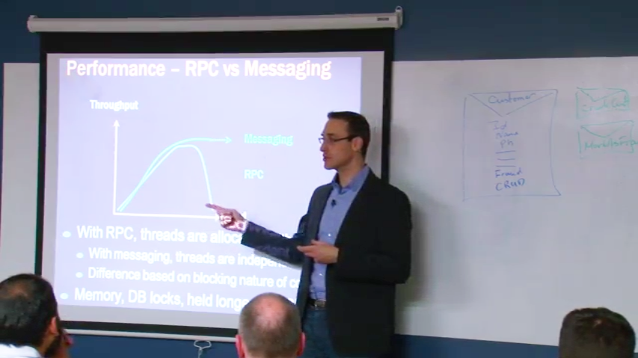

Bonus
Learn to design better systems
Get access to 2 full days of Udi Dahan’s Advanced Distributed Systems Design video course.
Sign up here: http://go.particular.net/.NETHamburg
Access code: BJMYYC
Expiration date: Sep. 17th

Slide 21

Questions?

Slide 22
More info
http://particular.net/HandsOnLabs
http://particular.net/Videos-and-Presentations
http://www.udidahan.com/?blog=true
Examples and slides
https://www.spacetelescope.org/images/potw1530a/

Slide 23
References
D. Boike, Learning NServiceBus, Packt Publishing 2013, ISBN-13: 978-1782166344
http://www.cs.cornell.edu/andru/cs711/2002fa/reading/sagas.pdf
https://lostechies.com/jimmybogard/2013/05/14/saga-patterns-wrap-up/
G. Hohpe, Enterprise Integration Patterns, Addison-Wesley Professional 2003, ISBN-13: 978-0321200686
https://www.spacetelescope.org/images/potw1530a/

Slide 24
Contact details
Email: boris.tveritnev@gmail.com
XING: www.xing.com/profile/Boris_Tveritnev
LNKD: de.linkedin.com/pub/boris-tveritnev/11/3a4/113/
Github: https://github.com/siniypin
https://www.spacetelescope.org/images/potw1530a/

Slide 25
Thank you!
Boris Tveritnev, 2015, Hamburg

